Slide 1
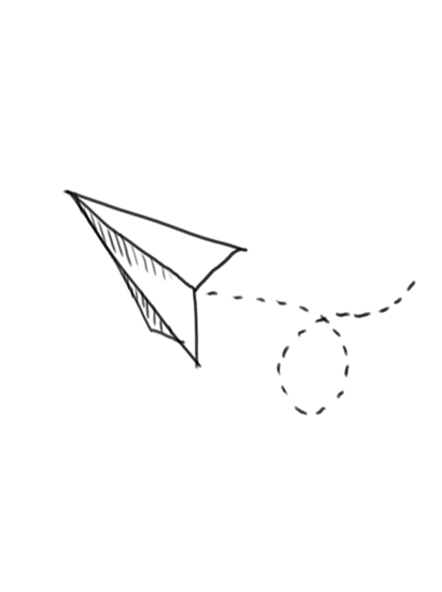
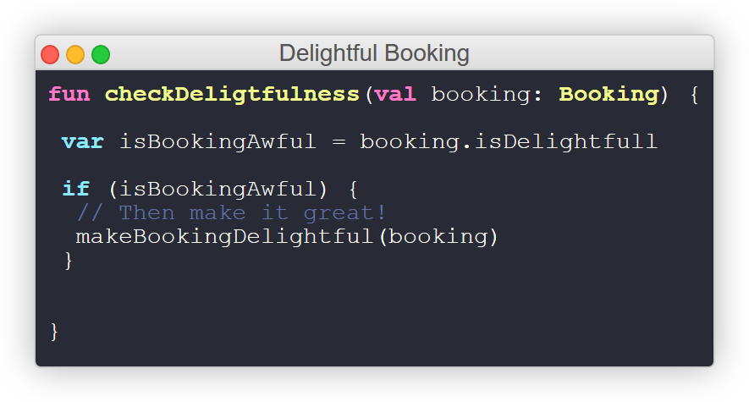
Project Delightful Booking

Slide 2
The Problem

Slide 3
Problem statement
If we consider leisure travellers, 55% of them take 1-2 vacations a year*, and spend a lot of time planning these trips
*Google/Phocuswright, 2016

Slide 4
What customers do today
Nowadays people looking for different options on different websites and waste a lot of time
The average traveler visits over 20 different travel websites before making a booking

Slide 5
A little of statistics
40%
Travellers bounce back and forth between dreaming about and planning their next trip
Explain why you’re focusing on a particular part of the problem or a particular subset of users

Slide 6
Solution Proposal

Slide 7
Completely personalized booking
Instead of asking about exact dates it is better to ask what would like a person to experience

Slide 8
Benefits
Focusing on three main aspects:
Intuitive Highlight what’s new, unusual, or surprising.
Personalized Adjusts itself to customer needs.
Essential Focused on what is really important

Slide 9
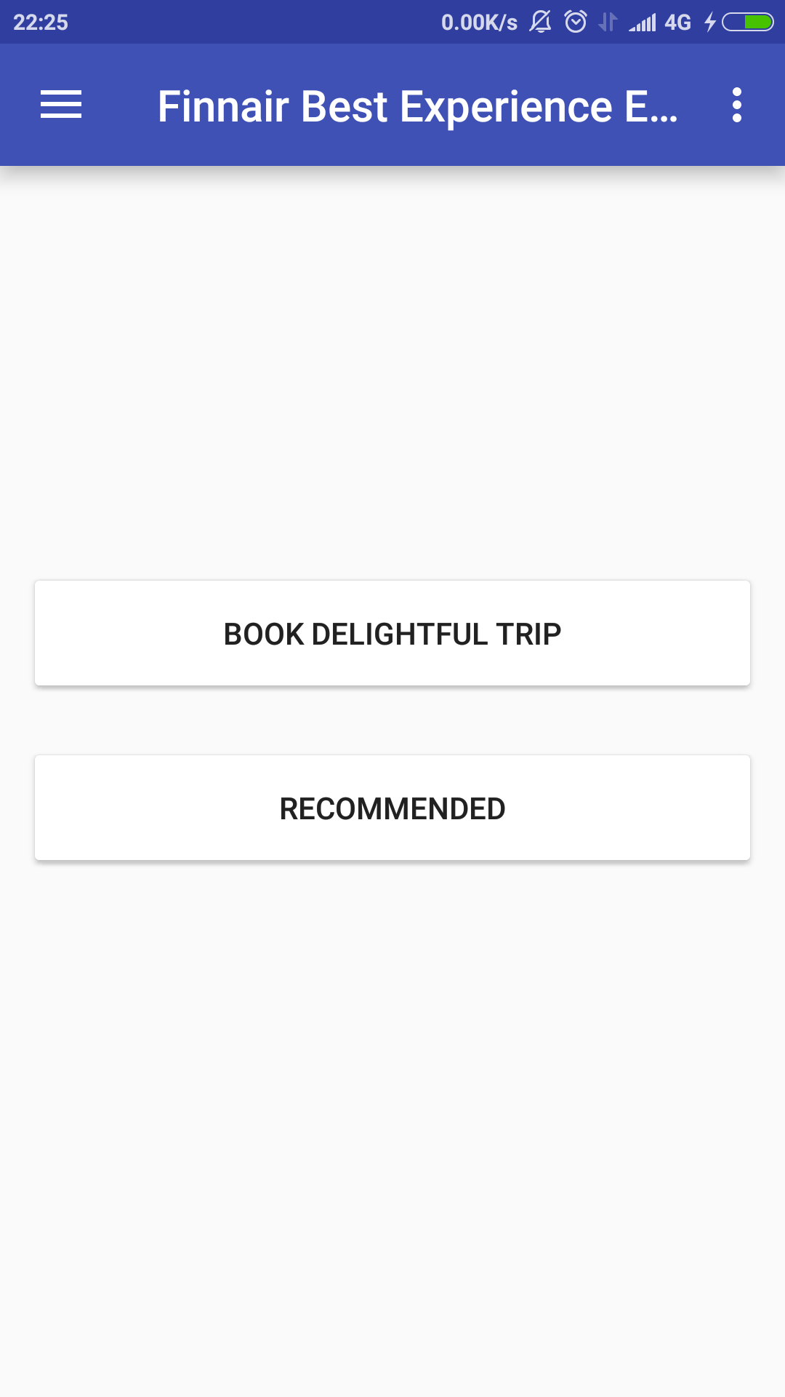
Component Detail (Mobile)
Booking a flight by preferences
Find flights based on user activity in social medias and other services

Slide 10
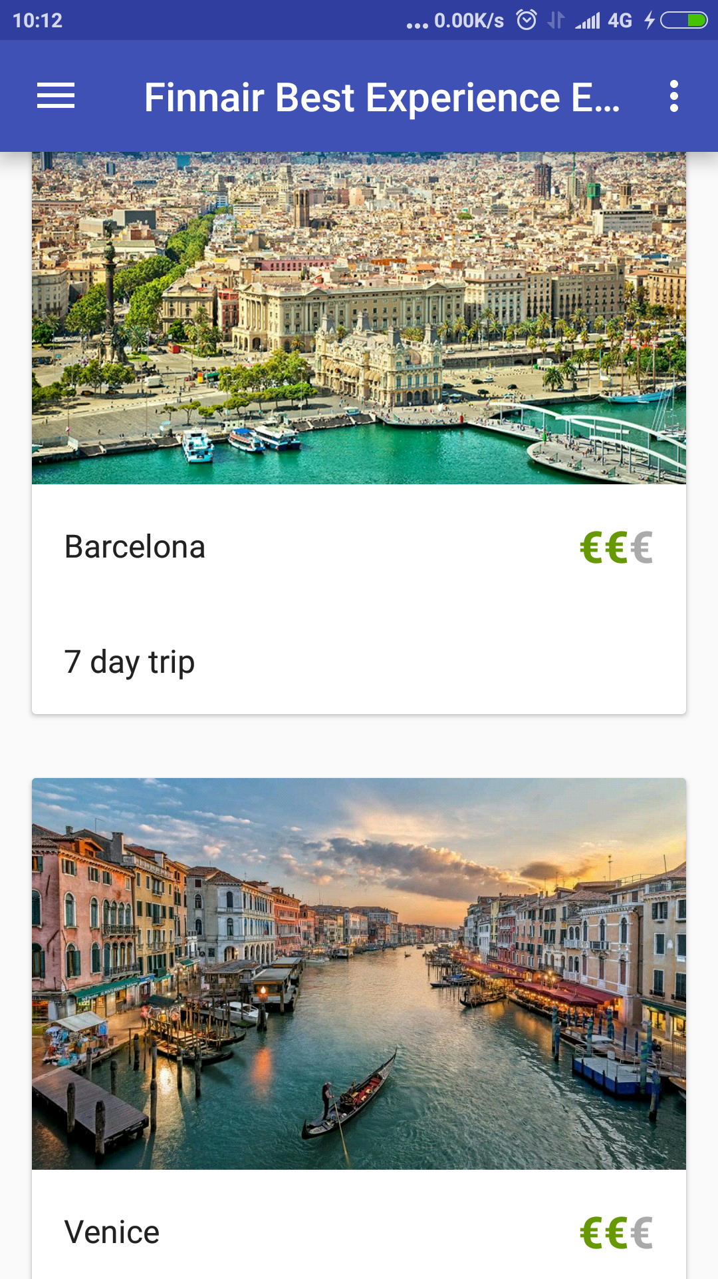
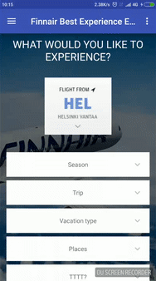
Recommended and Booking Screens (Mobile)

Slide 11
Implementation
AI driven user preferences detection. Analyzing user activity in social media: likes, posts, friend’s activity
Images are analyzed by image detection tools like IBM Watson Image recognition

Slide 12
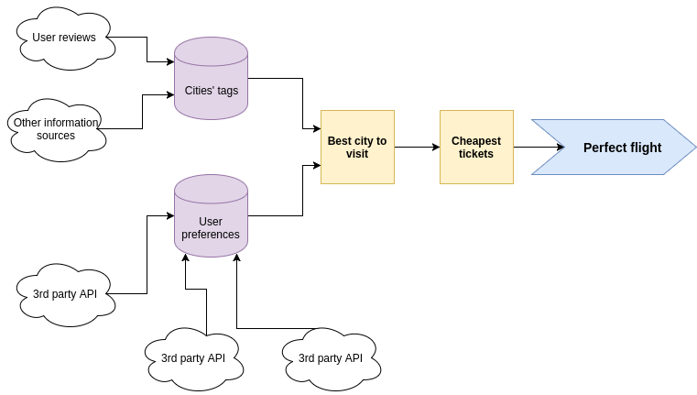

Slide 13
Demo showcase

Slide 14
Next Steps

Slide 15
How about next gen ads?!
Social media AI scan
3rd party services integration to provide more personalized offers

Slide 16
Spotify api usage

Slide 17
Dream listening your favorite artist in front of you?
Using Spotify Api we can get most popular artists of a user and then based on that offer best deals to make a dream come true!

Slide 18
Search based on user’s review
To perform better search results reviewing system can be implemented. By the end of flights users will be asked to complete questionnaire or smoy other type of review. By using keywords, search results can be more expanded and accurate

Slide 19
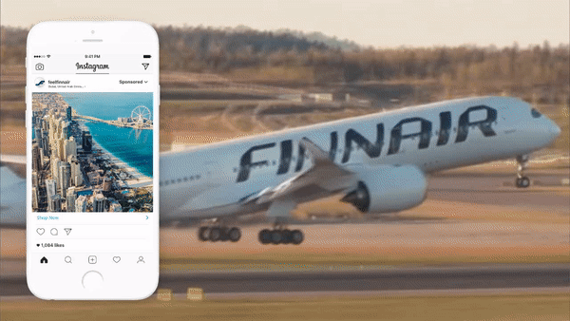
Questions?

